Slide 1

Why NBA is a Competitive Game?
By Yifan Bai, Nathan Chan, Val Gao
This Photo by Unknown Author is licensed under CC BY-NC

Slide 2
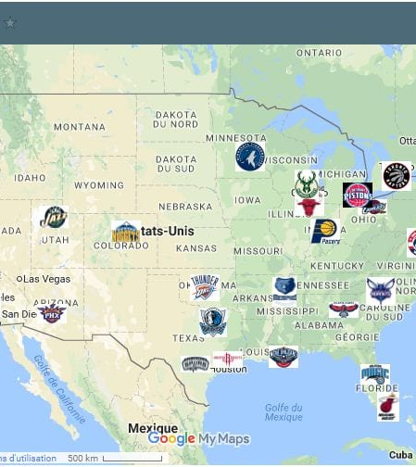
What is NBA, and Why it is interesting
The National Basketball Association (NBA) is the world's top men's professional basketball league. The target group is NBA fans
They might gain some stories. Why should someone care? Because this isn’t just a report; it’s a journey into understanding the heart and soul of the NBA – its players. Picture this: you’re watching an NBA game, cheering for your favorite player, and a question pops up – “Is this player worth their million-dollar salary?”
This Photo by Unknown Author is licensed under CC BY-NC-ND

Slide 3

The Overview of Project(What and why are we doing this?
this study aims to explore the value of NBA players and the reasons behind the NBA's ability to maintain the highest level of competition and substantial salaries through multidimensional data analysis using R. Our analysis focuses on the following three questions for three members:
1. How do players' physical attributes affect their performance in games, and how does this performance reflect their competitiveness in the NBA?
2. What are the distribution and trends of salaries in the league?
3. Does players' compensation correlate with their minutes per game and actual scoring per game?

Slide 4




Overview of Data
Dataset 1- all seasons.csv (Part 1): We selected datasets containing players' physical attributes that affect their performance in
Dataset 2- NBA Payroll(1990-2023).csv(Part 2): We chose datasets containing players’ Salary and time.
Dataset 3-NBA 2022-23 all stats with salary.csv (Part 3): We selected datasets containing players' salaries to explore whether they align with their on-court performance, like minutes and points.
We get it from the Kaggle website, and the data quality and reliability are good.
All of these datasets are publicly available, although some data on salaries may be restricted to non-commercial or academic research purposes.
This Photo by Unknown Author is licensed under CC BY-NC

Slide 5
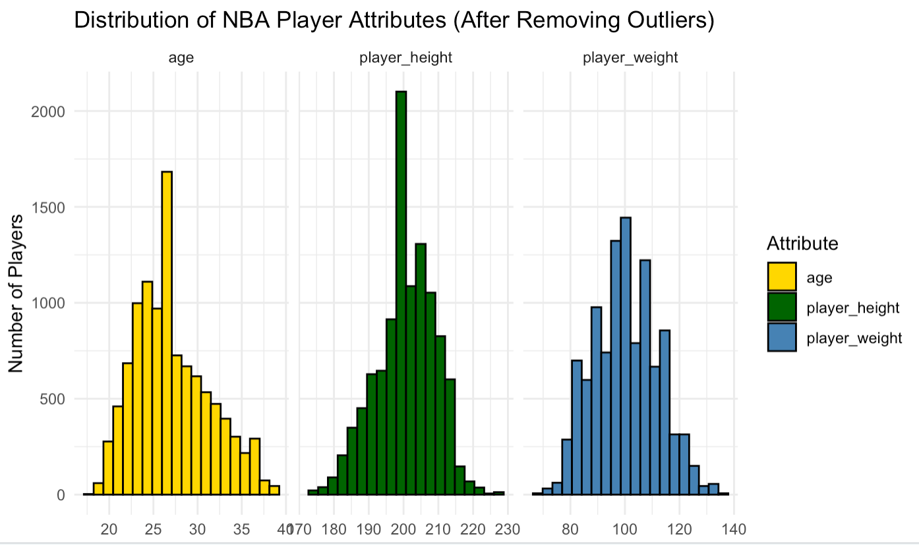
Distribution of NBA Player Attributes
We utilized descriptive statistical methods by creating visualized histograms to show how NBA is a competitive game.
Age: most distributed from 20 to 30 years old.
Height: most distributed from 190 to 210cm
Weight: most distributed from 90 to 110kg.

Slide 6
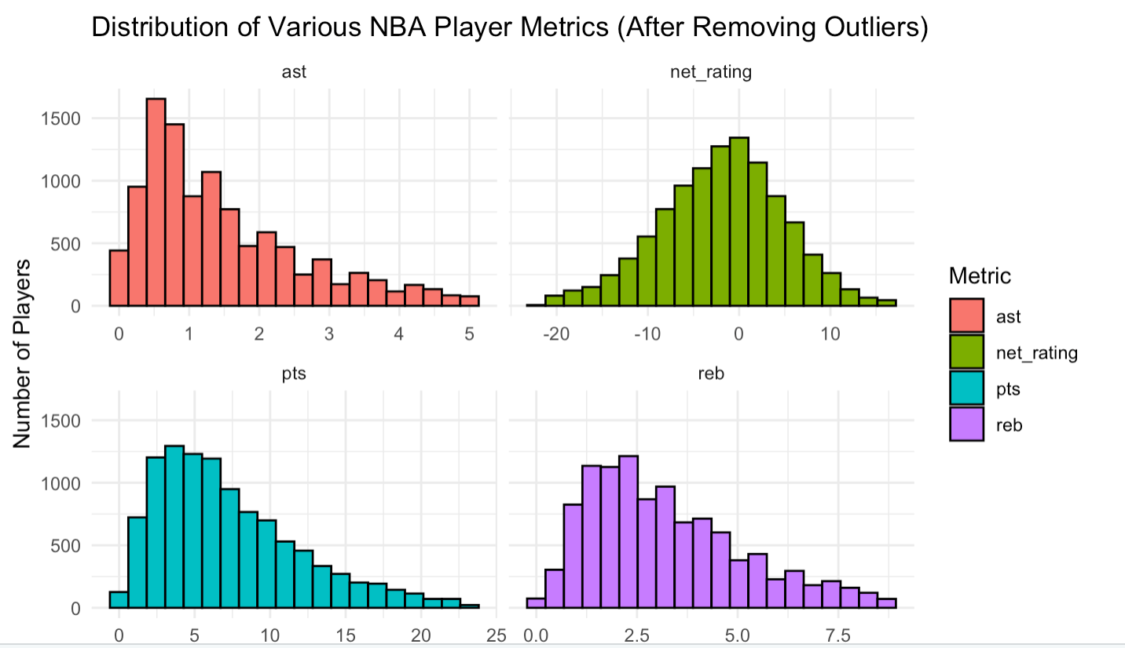
Distribution of Various NBA Player Metrics
we used the IQR method to eliminate outliers from these metrics.
These histograms provided an insightful depiction of the performance standards of NBA players’ competitiveness.
Three of them are right-skewed, which shows how hard to play in the NBA game.

Slide 7
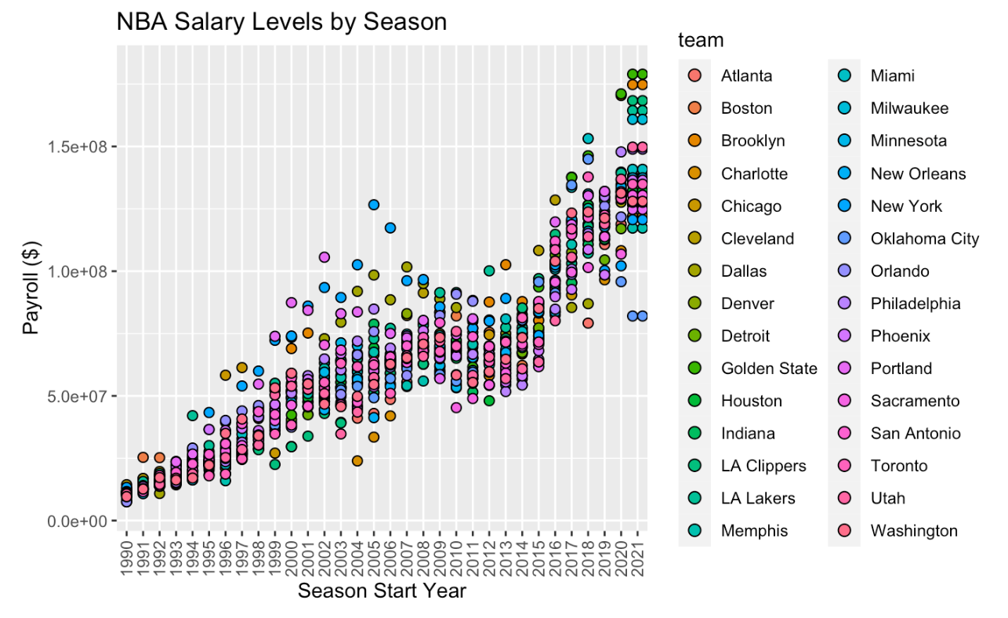
NBA Salary Levels by Season
First, we filtered out rows with missing values in the 'payroll' column.
The visualization aspect created dot plots, a method that effectively showcased the trends and variations in salary distribution across different seasons.
The upward trend of evolution of NBA salaries over time.

Slide 8
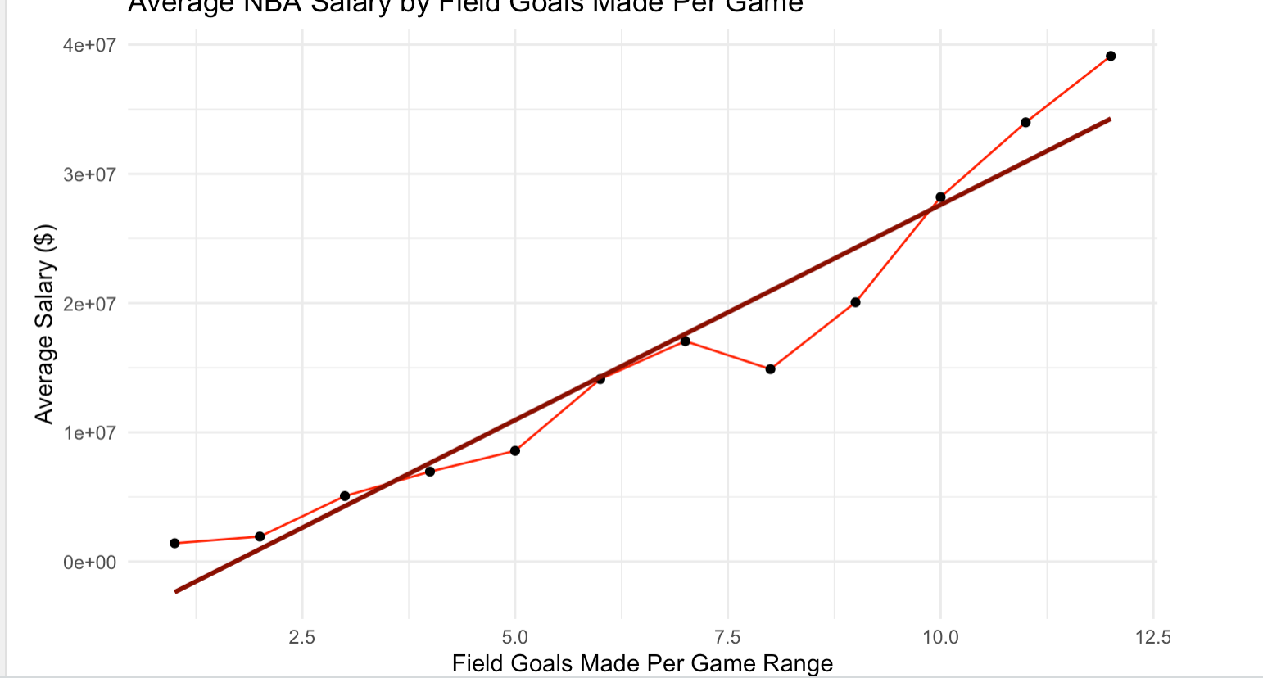
Average NBA Salary VS Field Goal Made Per Game
The combination of linear regression and line graphs provided a multi-faceted understanding of how NBA players' salaries correlate with their on-court contributions.
Regression analysis to explore the relationship, resulting in line graphs.
(Positive) A player who has more Salary would have more field goals made per game.

Slide 9
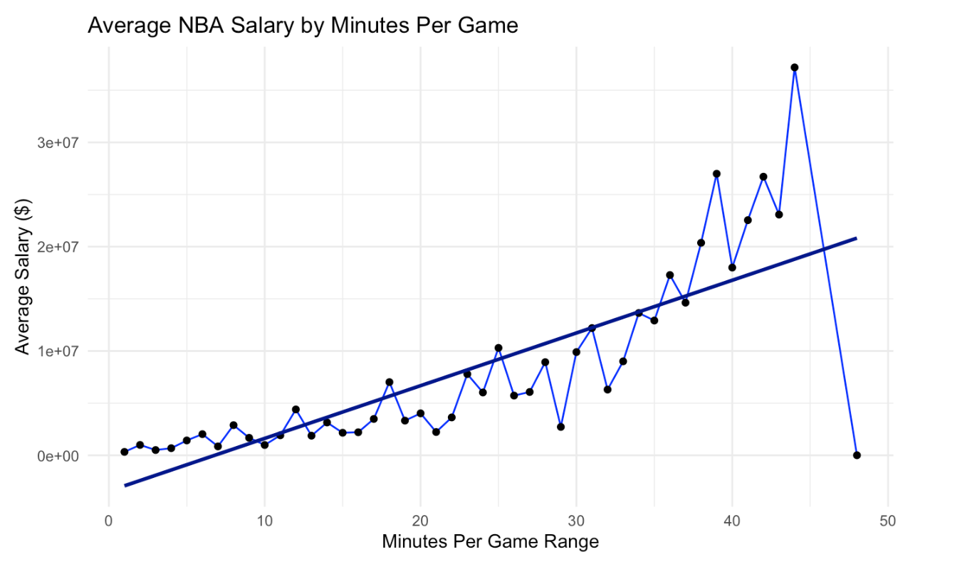
Average NBA Salary VS Minutes Per Game
The combination of linear regression and line graphs provided an understanding of how NBA players' salaries correlate with their on-court contributions(Minutes per game)
(Positive) A player who has a higher salary would have more minutes played per game.

Slide 10

Conclusions from data and result
Establishing correlations between player salaries and performance metrics
Our analytical approach, combining linear regression models with visually compelling histograms, dot graphs, and line graphs, shows the dynamics between NBA salaries and on-court contributions.
For the future, the NBA continues to evolve our comprehensive analysis of NBA player salaries is important for shaping future strategies and evaluating new player’s ability in playing NBA

